Slide 1


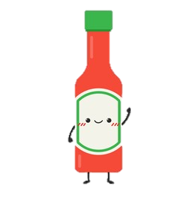
SourcE-commerce
HOT!
Presented to you by TEAM Awesome-Sauce
e-Commerce
(Soy Sauce) | (Hollandaise Sauce) | (BBQ Sauce) | (Tamacco Sauce)
Jessie Ng | Fraser Clarke | Mushtaq Safie | Fatima Fakih

Slide 2
“It’s one small step for the internet, one giant leap for e-commerce.”
Elevator Pitch

Slide 3

Concept
DESCRIPTION
An inventory & sales tracker for businesses, coupled with a simple, clean storefront for customers!
USER STORY (two-fold)
AS A Business Owner… I want to be able to track my inventory & sales performance so that I can better manage different aspects of my business based on items ordered in my ‘storefront’.
AS AN Online Shopper… I want to be able to see product information (i.e. name & price) so that I can shop for items I want.
MOTIVATION FOR DEVELOPMENT
With e-commerce growing in popularity, especially in the wake of Covid, it is now more important than ever for businesses to be able to accurately track their business performance and inventory when customers shop their products.
Customers get a user-friendly e-Storefront and businesses get an intuitive application by having both elements within the same platform.

Slide 4
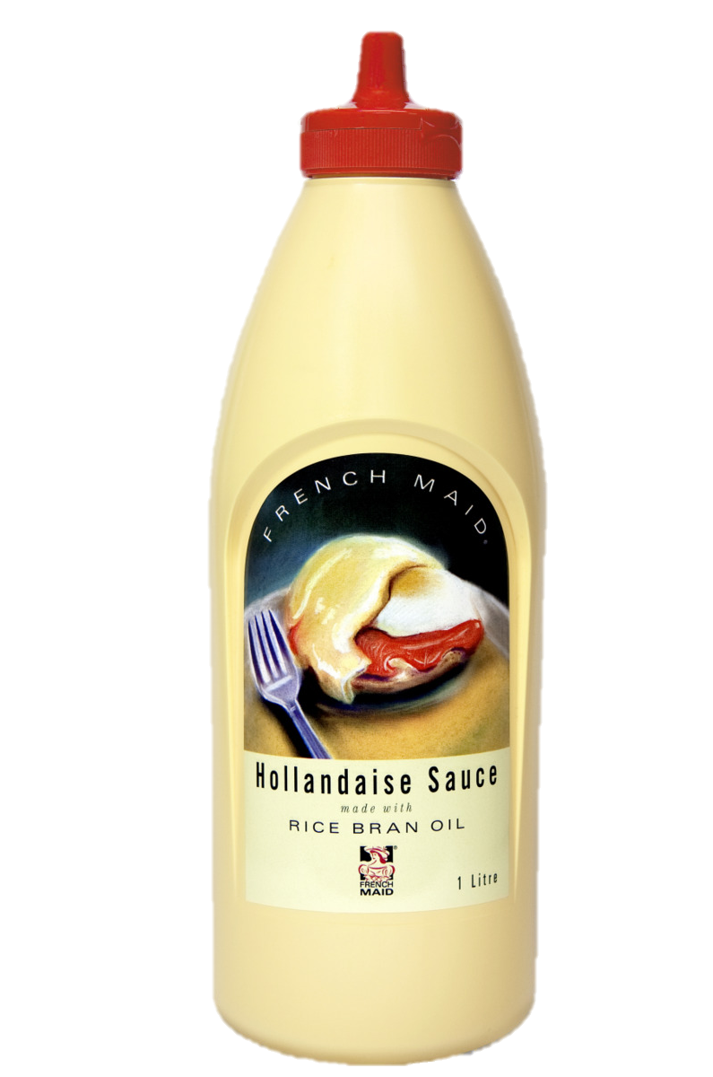

Process
Technologies Used:
HTML, CSS, JavaScript
Bootstrap CSS & FontAwesome
Node Environment
Express.js Framework
MySQL Database
Sequelize ORM
Handlebars.js
Heroku Platform
Highcharts library
Crypto & Cookie Parser package
Challenges:
Travis
Authentication
Handlebars helper expressions
Get / Post Requests
Successes:
PROJECT FINISH! 🎉
Incorporate Highcharts
Handlebars implementation
Integration between pages despite different client types
Breakdown of tasks & roles:
JESSIE (Front-end)…
Project Manager & Repo Setup
HTML via handlebars, CSS & JavaScript w/Highcharts
FRASER (Front-end)…
HTML via handlebars & JavaScript
API Requests
MUSHTAQ (Back-end)…
MySQL Database w/Sequelize, JavaScript
API Requests & Routes
FATIMA (Back-end & Front-end support)…
Login & Create authentication w/Cookie Parser
Front-end support w/JavaScript

Slide 5

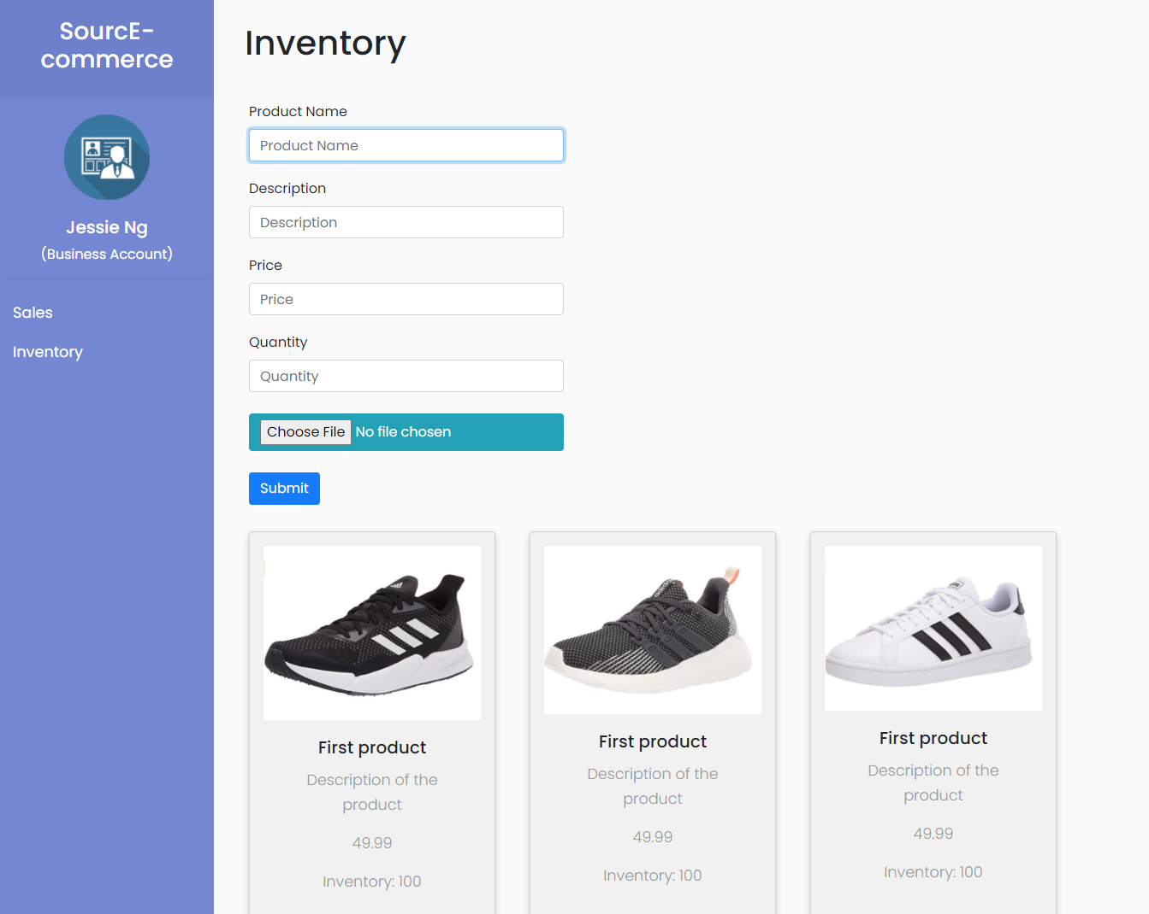
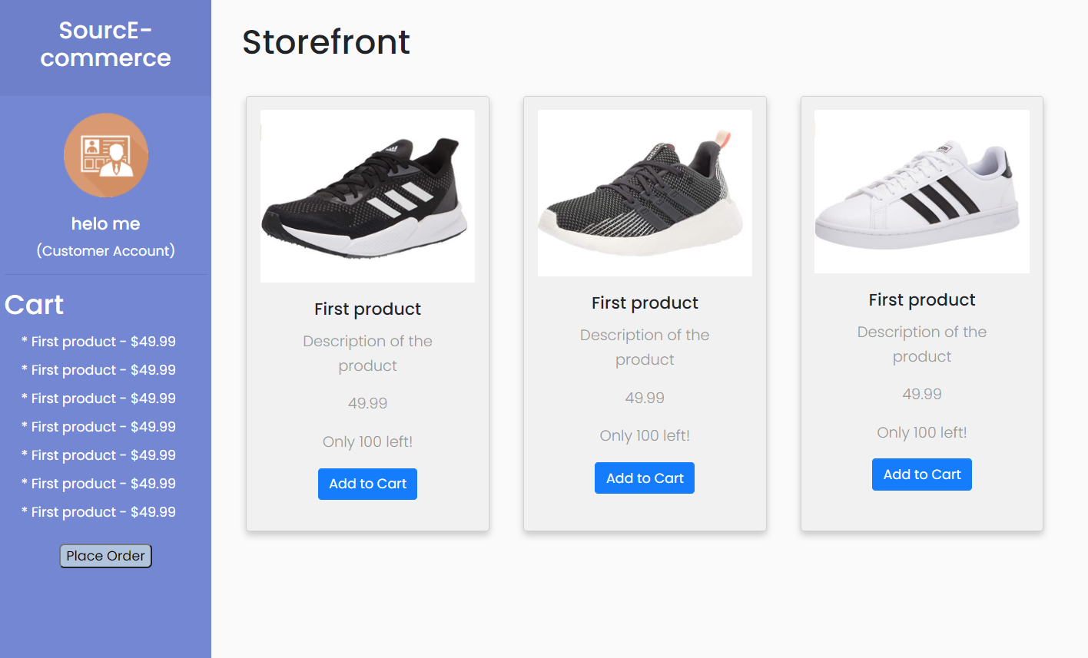
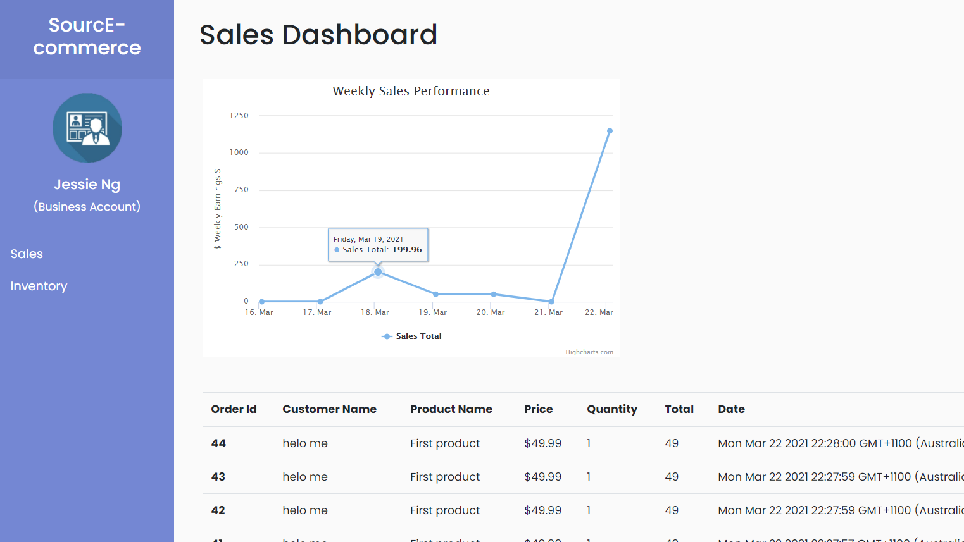

DEMO
Have a look at our Heroku-deployed application HERE!

Slide 6

Future Development
Add a User Account Management Page to allow users to update personal details
Allow user to add custom photo at account creation & have it displayed on sidebar as user photo
Add log out functionality
Add exportable data for Business Owners: Sales Data & Inventory List
Update Inventory on Business side as Customer places new order of selected items
Implement search capability for both Customers & Businesses to locate a specific product or find Sales Data from a desired date range
Allow Businesses to have multiple storefronts
Enable Storefront to be more interactive (i.e. Updatable qty of items, subtotal, checkout feature

Slide 7


Links
Heroku Deployed Application
https://murmuring-bastion-13699.herokuapp.com
GitHub Repository
https://github.com/MissNG-Git/SourcE-commerce
HOT!
e-Commerce

